Slide 1
Review
Analysis model
  Identify what domain classes to realize functionalities
How to do these to meet requirements?
  Choose technology to meet performances

Slide 2
Part 3 Design chapter 09 Design Introduction

Slide 3
Outline
What
Why
How

Slide 4
What is design?
Refine and expand analysis model into design model, make it straightforward for implementation.
The design model provides detail about data structures, architecture, interfaces, and components that are necessary to implement the system. The analysis model is an abstraction, or generalization, of the design. It omits most of the details of how the system works and provides an overview of the system's functionality.

Slide 5
What is design? (continued)
The goal of design is to produce a model that exhibits firmness, commodity, and delight.
正确做事do the thing right ( analysis：做正确的事 do the right thing）
Decisions about how to do
Blueprint, plan, roadmap, guideline
软件利润 = 需求 - 设计
It is craft, science, engineering, or something else entirely. Finally, it is art.
Notes:
Firmness: a program should not have any bugs that inhibit its function. Commodity: A program should be suitable for the purpose for which it was intended. Delight: The experience of using the program should be a pleasurable one.

Slide 6
Why design?
Design is the place where software quality is established.
Without design, we risk building an unstable, difficult test and maintainable system.
Design sits at the technical kernel of SE and is applied regardless of the software process model that is used.
Design is the place where creativity rules.
Notes:
During Design we make decision that will ultimately affect the success of software construction and, as important, the ease with which software can be maintained.

Slide 7
Why design? (continued)
中国改革开发的总设计师 邓小平
史蒂夫·乔布斯（1955-2011）， Steve Jobs . Macintosh、iMac、iPod、iTunes、iPhone、iPad.
Sydney opera(悉尼歌剧院):十大人造奇迹第五名. 设计师：丹麦 约恩·乌松, Pritzker Prize, architecture's highest honor.

Slide 8
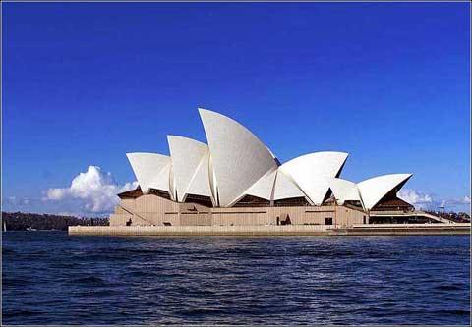
Sydney opera model

Slide 9
Why design? (continued)
“天下西湖三十六，最美是杭州”，千年前苏东坡大学士对西湖精采绝伦的系统设计，使杭州荣升为“天堂”，让后人只剩下赞叹和破坏的份了.
Microsoft windows NT designer: own 8 Ferrari sport cars让Microsoft公司的一些程序员十分眼红。但你只能羡慕而不能愤恨，因为并不是每个程序员都有本事成为复杂软件系统的设计师。
Oracle, 2013年，甲骨文已超越 IBM ，成为继 Microsoft 后全球第二大软件公司。
  拉里·埃里森(Larry Ellison)

Slide 10
Design process
Software design is an iterative process:
preliminary design: makes strategic decisions about subsystems of software and its relationships, formulate an architecture.
detail design: decisions about procedure of component in each subsystem.
An example: a team partition
  Analysis, design, coding, test…

Slide 11
Elements of the design model
Data elements
Architectural elements
Component elements
Interface elements
Deployment elements

Slide 12
Data elements
Today, business large and small are awash in data.(big data)
Persistent data: data survives past the execution of the process that created it.
  File store
  DBMS
Data tomb: Data rich, knowledge poor
  Data mining technique
  Data warehouse: OLAP

Slide 13
Architectural elements
Decision on how to divide a monolith system into some intellectually manageable subsystem.
Defines the relationship between major subsystems, the architectural styles and design patterns that can be used to achieve the requirements defined for the system.
  B/S architecture
  MVC pattern

Slide 14
Component elements
Transforms structural elements of the software architecture into a procedural description of software components.

Slide 15
Interface elements
External interface: Describes how the software communicates with system that interoperate with it.
UI: humans or systems who use it.
Internal: modeling how components are integrated to function as a whole system.
近年来，人机界面在系统中所占的比例越来越大，在个别系统中人机界面的设计工作量甚至占总设计量的一半以上。
一见钟情

Slide 16
Deployment elements
Allocate the architecture, its components, and the interfaces to the physical configuration that will host the software.

Slide 17
Analysis distinct from design
Analysis: refine and structure requirements
  precise and detailed understanding of the requirements
Design: shape the system that meets these requirements
  technology choices
  design alternatives
  non-functional requirements
  computer-speak details

Slide 18
Review
Design
  Decision
  Software quality
  Creative efforts

Slide 19
How to design?
Although design is individually creative effort，there are these:
Principles
Concepts
Practices

Slide 20
Principles
Kiss: keep it simple and stupid
Design must be traceable to the analysis model.
Always consider architecture
Focus on the design of data.
Interfaces (both user and internal) must be designed
Notes:
Independence declaration

Slide 21
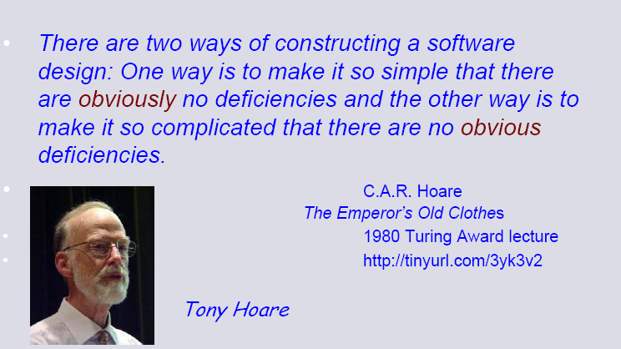
Principles---simplicity

Slide 22
Principles (continued)
Components should exhibit functional independence.
Components should be loosely coupled
  Law of Separate of concern¹
Design representation should be easily understood
The design model should be developed iteratively
Notes:
1爱情不是亲密无间，而应是宽容“有间”。结婚后，每个人都有自己的交往圈子，夫妻双方有时模糊点、保留点，反而更有吸引力，给别人空间，也是给自己自由。请记住，婚姻不是占有，而是结合，所谓结合，就像联盟，首先要尊重对方。
Open close principle

Slide 23
Design concepts
A set of fundamental software design concepts has evolved over the history of SE.
Provide the necessary framework for “getting it right”

Slide 24
Design concepts---abstraction
Abstraction is one of the fundamental ways that we as humans cope with complexity.
  Abstract classes
  interfaces
When we consider a modular solution to any problem, many levels of abstraction can be posed.

Slide 25
Design concepts---architecture
Architecture is centric in many today’s system.
A pig picture of the system
A higher level abstraction of the system

Slide 26
Design concepts---patterns
A pattern is a proven solution to a recurring problem.
  Washing hands before meal
Design patterns…: a classical book by Four Gang.

Slide 27
Design concepts---modularity
Divide the system into separately named and addressable components ( modules).
Software architecture and design patterns embody modularity.

Slide 28
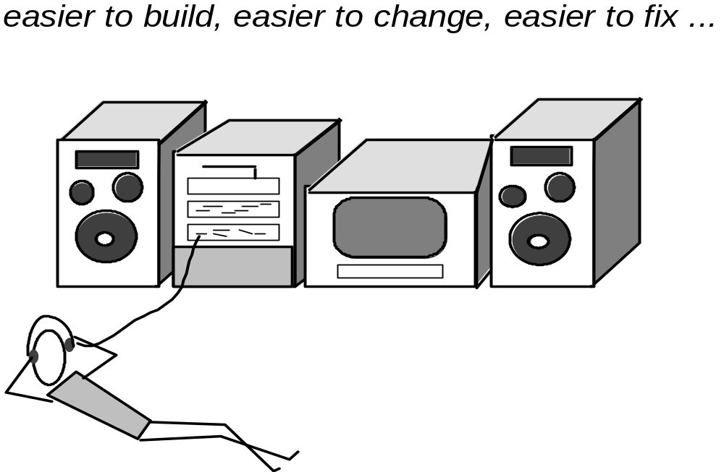
Modular Design

Slide 29
Modularity: Trade-offs
What is the "right" number of modules
for a specific software design?
module development cost
cost of
software
module
integration
cost
optimal number
number of modules
of modules

Slide 30
Design concepts---information hiding¹
reduces the likelihood of “side effects”
limits the global impact of local design decisions
emphasizes communication through controlled interfaces
discourages the use of global data
leads to encapsulation—an attribute of high quality design
results in higher quality software
Notes:
开闭原则（Open Closed Principle）开闭原则的核心是：对扩展开放，对修改关闭
工作重地，非请莫入

Slide 31
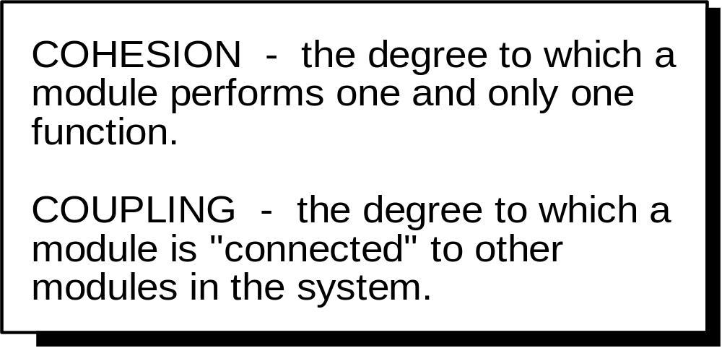
Design concepts--- Functional Independence

Slide 32
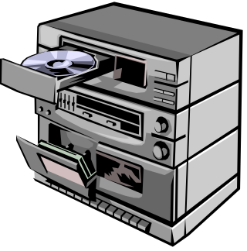

Coupling
Coupling indicates the degree of interdependence between two modules
Law of least knowledge¹
  Each unit should have only limited knowledge about other units
  Only talk to your friends who share your concerns
Example of low coupling:
  Stereo System
Notes:
OO设计的重要原则（六大原则）：就是说一个对象应当对其他对象有尽可能少的了解。 不要和陌生人说话，知道多，死得快。
talk”，其实就是对象间方法的调用。这条规则表明了对象间方法调用的原则：
（1） 调用对象本身的方法；
（2） 调用通过参数传入的对象的方法；
（3） 在方法中创建的对象的方法；
（4） 所包含对象的方法。
The Law of Demeter (LoD), or Principle of Least Knowledge, is a design guideline for developing software, particularly object-oriented programs. (wikipedia)
While everyday working on code that was written by lazy coders or junior coders I see a lot of violation of this law. I think every programmer should know the Law of Demeter by heart, as it states.
Any method of an object should call only methods belonging to:
1. Itself
2. Any parameters that were passed in to the method
3. Any objects it created
4. any directly held component objects

Slide 33
Advantages of Loose Coupling
The fewer connections between modules, the less chance of a defect in one causing a defect in another
The risk of having to change other modules as a result of changing one module is reduced
The need to know about the internals of other modules is reduced when maintaining the details of other modules.
But of course we have to have some coupling!

Slide 34
Cohesion
Is the measure of the strength of functional relatedness of elements within a module

Slide 35
Coupling and cohesion
比如手和脚是两个“功能独立”的模块。没有脚时，手照样能干活。没有手时，脚仍可以走路。但如果希望跑得快，那么迈左脚时一定要伸右臂甩左臂，迈右脚时则要伸左臂甩右臂。在设计一个模块时不仅要考虑“这个模块就该提供什么样的功能”，还要考虑“这个模块应该怎样与其它模块交流信息”。

Slide 36
OO Design Concepts
Inheritance—all responsibilities of a superclass is immediately inherited by all subclasses
Messages—stimulate some behavior to occur in the receiving object
Polymorphism—a characteristic that greatly reduces the effort required to extend the design

Slide 37
Design Classes
Analysis classes are refined during design to become entity classes
Boundary classes are developed during design to create the interface (e.g., interactive screen or printed reports) that the user sees and interacts with as the software is used.
  Boundary classes are designed with the responsibility of managing the way entity objects are represented to users.

Slide 38
Design Classes (continued)
Controller classes are designed to manage
  the creation or update of entity objects;
  the instantiation of boundary objects as they obtain information from entity objects;
  complex communication between sets of objects;
  validation of data communicated between objects or between the user and the application.

Slide 39
Inheritance
Design options:
  The class can be designed and built from scratch. That is, inheritance is not used.
  The class hierarchy can be searched to determine if a class higher in the hierarchy (a superclass)contains most of the required attributes and operations. The new class inherits from the superclass and additions may then be added, as required.
  The class hierarchy can be restructured so that the required attributes and operations can be inherited by the new class.
  Characteristics of an existing class can be overridden and different versions of attributes or operations are implemented for the new class.

Slide 40
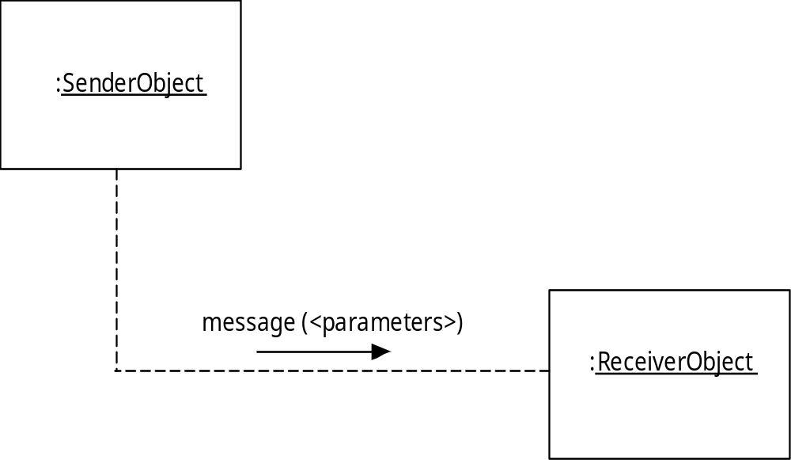
Messages

Slide 41
Polymorphism
Conventional approach …
case of graphtype:
if graphtype = linegraph then DrawLineGraph (data);
if graphtype = piechart then DrawPieChart (data);
if graphtype = histogram then DrawHisto (data);
if graphtype = kiviat then DrawKiviat (data);
end case;

Slide 42
Polymorphism (continued)
All of the graphs become subclasses of a general class called graph. Using a concept called overloading. Each subclass defines an operation called draw. An object can send a draw message to any one of the objects instantiated from any one of the subclasses. The object receiving the message will invoke its own draw operation to create the appropriate graph.
graphtype.draw

Slide 43
Polymorphism (continued)
One abstraction, many specific implementantion.

Slide 44
Design practices
Patterns
Framework

Slide 45
Design practices (continued)
Patterns
  solution to similar problems
  Look for every opportunity to reuse existing design patterns rather than creating new ones
  Patterns are half-baked, you always have to finish them yourself and adapt them to your own environment.

Slide 46
Design practices (continued)
Framework
  an extension of patterns, provide an architecture skeleton within a specific application domain.
  A semi-product. MFC is composed of many c++ classes……

Slide 47
Design practices (continued)
A framework is not an architectural pattern, but rather a skeleton with a collection of “plug points” (also called hooks and slots) that enable it to be adapted to a specific problem domain.
Gamma et al note that:
  Design patterns are more abstract than frameworks.
  Design patterns are smaller architectural elements than frameworks
  Design patterns are less specialized than frameworks

Slide 48
Key points
Good design for high quality software
Design elements
Design concepts
Design principles
Design practices

